Slide 1
A Brief History: Workshop on the Statistical Analysis of Multi-outcome Data (SAM)

Slide 2
History
Originated in 2010, discussing with John O’Quigley
Focus areas: joint model of multiple outcomes, recurrent events, multivariate longitudinal data
Only invited sessions
No parallel session – you have no choice!!!
Held in even years: 2012, 2014, 2016

Slide 3
First Workshop
1. Curie Institute (Institut Curie) in Paris, France
2. Two day workshop July 9-10, 2012
3. Twenty four invited speakers (8 sessions)
4. Around 100 participants

Slide 4
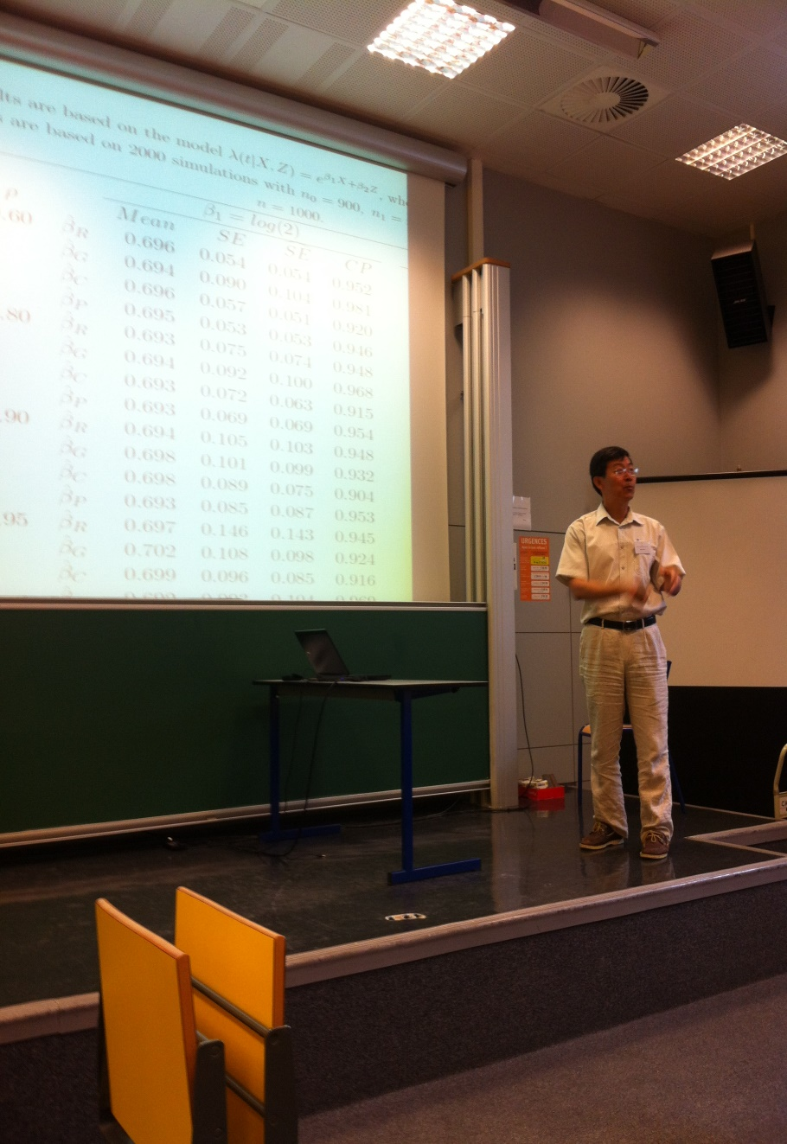


Slide 5
Second Workshop
1. In the University of Cambridge, UK
2. Two day workshop June 30-July 1, 2014
3. Twenty four invited speakers (8 sessions)
4. Website: http://www.phpc.cam.ac.uk/events3/statistical-analysis-of-multi-outcome-data-workshop/

Slide 6


Slide 7
Third Workshop
Renmin (People’s) University of China, Beijing
Two day workshop July 4-5, 2016
Add sessions on topics, e.g., high dimensional multi-outcome data

Slide 8
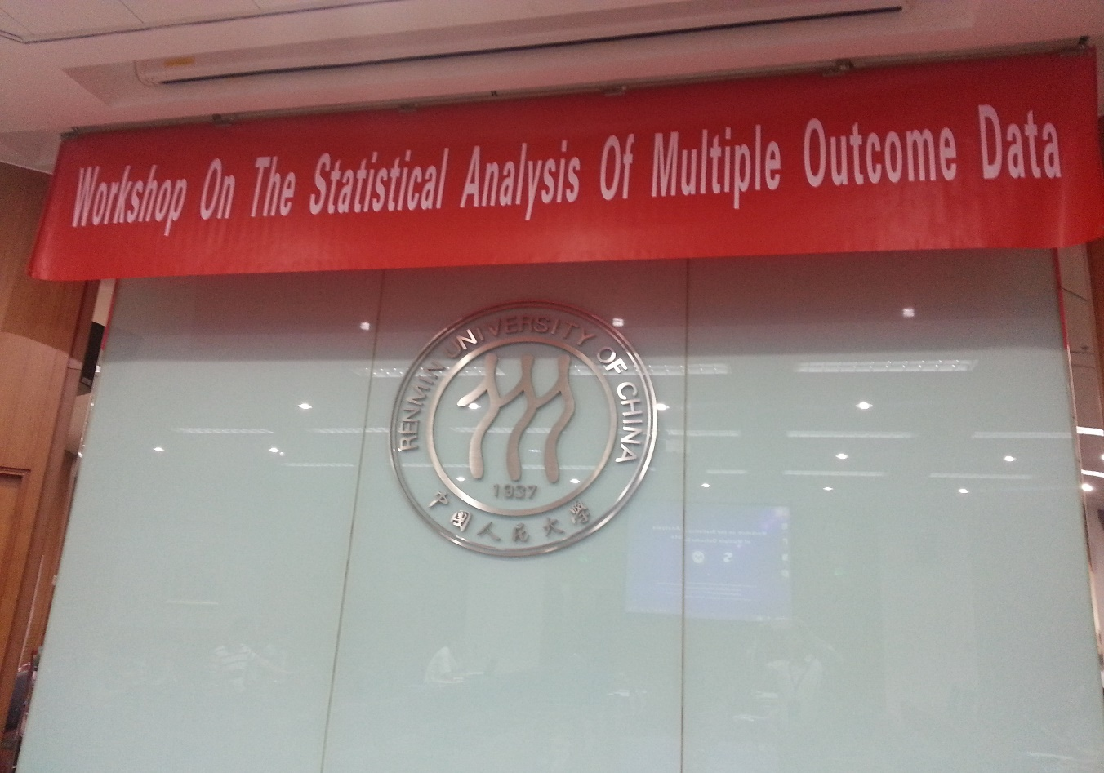
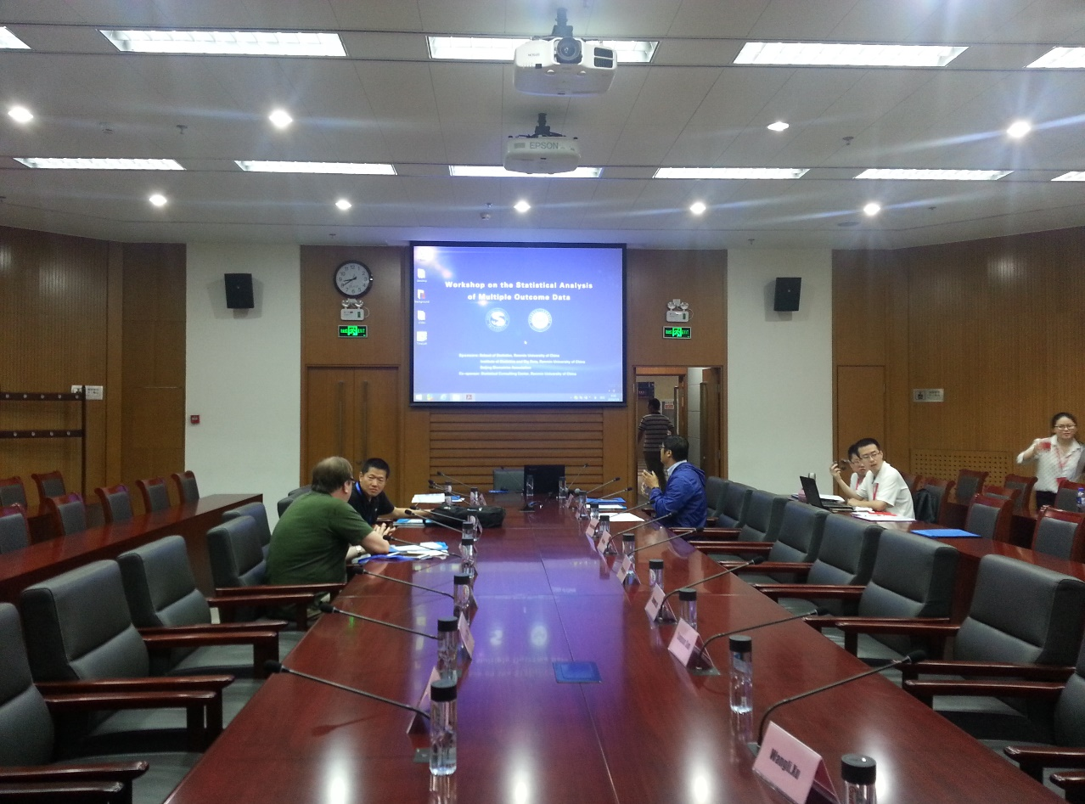

Slide 9
Fourth Workshop
Washington University in St. Louis
Two day workshop June 10-11, 2018
Add a poster session for graduate students and poster award for 5 students.

Slide 10
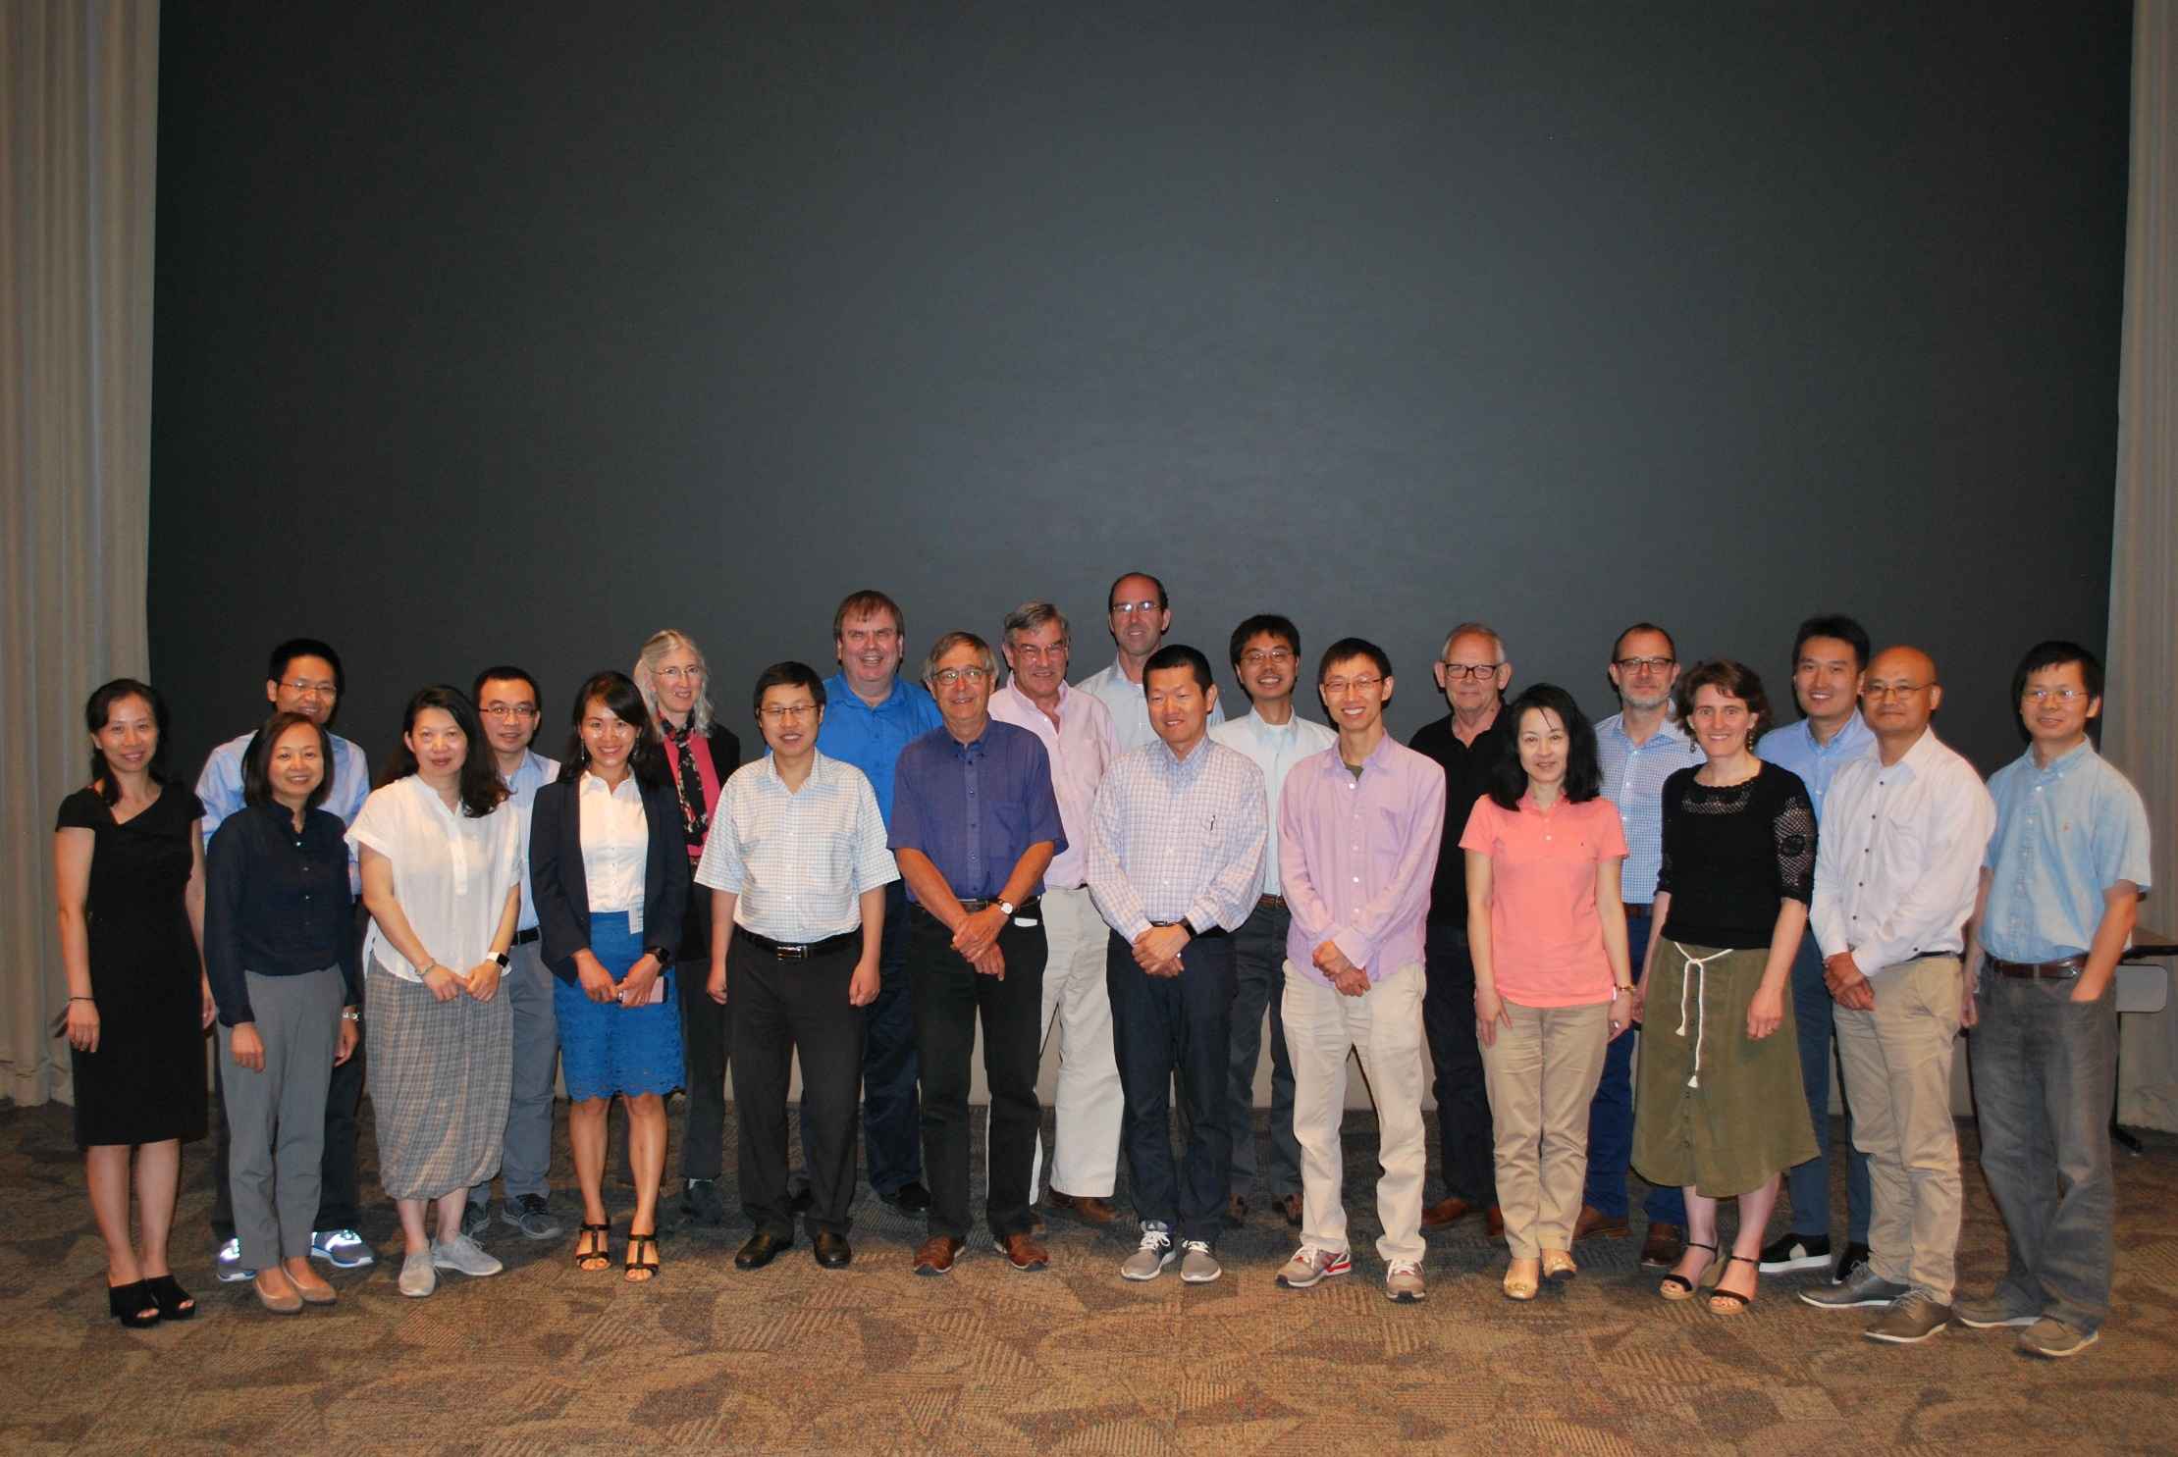

Slide 11
Acknowledgements
1. John O’Quigley and Phillip Saint Pierre
2. Jessica Barrett and Michael Sweeting
3. Yang Li and Feifang Hu
4. DC Rao, Philip Miller, and Chengjie Xiong

